Slide 1
Video Files
Nora Judge

Slide 2
What is a video file?
A video file is a type of file that can save digital video on a computer.
The type of video file can determine the overall quality and file size,
Different file types are used for different reasons.

Slide 3

Resolution
Resolution means the width and height of a video measured by pixels.
Example: 1080p video is 1920x1080 pixels.
Higher resolution means a need for more power and connection, and if this not meant the quality can be lost.
720p and below is Standard Definition or “SD”
1080p is High Definition or “HD”
4k and up is “Ultra High Definition” or “Ultra HD”
The type of codec and container can affect resolution.
Resolution Comparison. 2022. Plum Grove Incorporated, https://plumgroveinc.com/what-is-high-resolution/. Accessed 7 Nov. 2023.

Slide 4
Bit-rate
Often confused with resolution, Bitrate determines the speed of information over the internet and how much bandwidth it takes.
The standard unit of measurement is megabytes per second.
Higher bitrate results in higher video quality, as it can handle more information being processed.
When something has a high bitrate with poor internet access, the video will buffer.
Altaf, Sehar. Bitrate Comparsion. 29 July 2022. One Stream, https://onestream.live/blog/video-bitrate-a-complete-guide/. Accessed 7 Nov. 2023.

Slide 5
CODecs
Codec is an acronym for compress and decompress
It allows for video files to be compressed, as to not take up space, and than decompressed when played so they can be played at full quality.
Imagine you are moving homes and need to move a big piece of furniture. It is easier to take it apart and put it in a box than it would be to move it at full scale.
Compression can be lossy, quality is lost, or lossless, quality is maintained.
The most common codec is H.264

Slide 6
Containers
If a codec is the act of taking apart the big piece of furniture, a container is the box you store it in.
A video can include video, audio, subtitles, and all sorts of metadata, a container is what keeps it all together.
The container type is displayed at the end of the video, example: .mp4

Slide 7
MP4 (Mpeg-4)
Most common type of format.
Supports metadata, such as overlay text.
Ensures lossless compression.
Versatile with multiple extensions, mp4a and mp4v.
Does not work with many codecs.
Can’t protect creators from copyright infringement.

Slide 8
MOV
Great for video editing, developed by Apple for that Purpose.
Highly compatible, works with most formats.
Allows HD video editing.
Lossy compression.
Large file size.
Weak compatibility.

Slide 9
MKv
Excellent for video editing.
Compatible with any Codec.
Low Compatibility.
Slow.
Large file size.

Slide 10
Avi
Once the most popular format, beaten out by MP4.
Compatible with Windows, Mac, and Linux.
Supported by many codecs.
Lossy compression.
Not great for subtitles.

Slide 11
avchd
Created by Sony and Panasonic for HD camcorders.
Allows user to playback HD quality video in real time
Can give excellent sound quality.
Works well with Blu-ray.
Large file size.
Low compatibility.

Slide 12
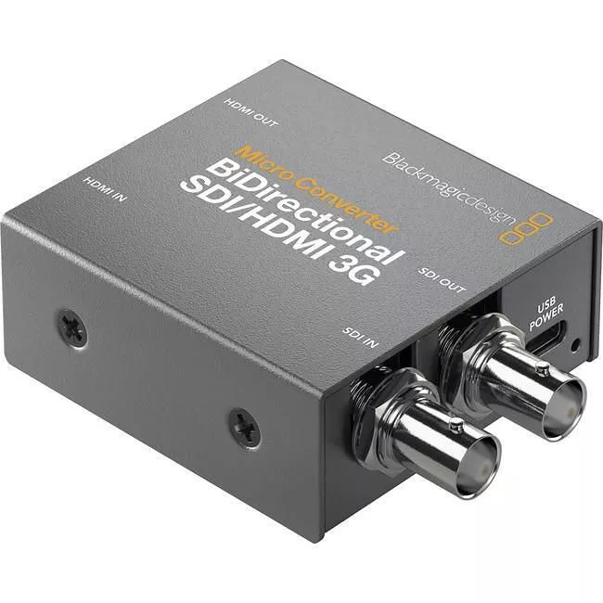
Converting video
There are two ways video is converted: through hardware and software.
Hardware is used during filmmaking. Video converters are adapters that allow cameras to broadcast video directly to monitors in real time.
Software converters do the same thing digitally, they can make a copy of the file in a new format or change the original.
Software can vary in speed, quality loss, transfer of metadata, user friendliness, etc.
BE CAREFUL DOWNLOADING FILES FROM FREE CONVERTERS.
Blackmagic Design CONVBDC/SDI/HDMI03G/PS Micro Converter BiDirect SDI/HDMI3G PSU. Sabrepc.Com, https://www.sabrepc.com/CONVBDC-SDI-HDMI03G-PS-Blackmagic-Design-S136770388. Accessed 7 Nov. 2023.

